Slide 1
Credit Card Fraud Detection
                By
                Srimukha Vasireddy

Slide 2
Contents
Introduction to the problem
Why machine Learning is needed to detect fraud transactions
Exploring machine Learning Technique
How a machine learning model gets implemented
Use cases of machine learning Technique
Pros and Cons of the technique
References

Slide 3
Introduction to the requirement
Credit cards are the staple of conveniency in modern world, but with the constant fear of theft or a breach in security, banks have upgraded fraud detection software with the power of machine learning and advanced classification algorithms.
With the machine learning techniques credit card companies shall be able to recognize fraudulent credit card transactions so that customers are not charged for items that they did not purchase.
We will use a machine learning algorithm that will be able to discern fraudulent from non-fraudulent one.
Here I would like to use Logistic regression model which predicts whether the transaction is fraud or not. To explain this in detail I have taken a data set which contains credit card transactions.

Slide 4
Why machine Learning is needed to detect fraud transactions
Frauds can be committed in different ways at different times and from different places , which is impossible to track manually.
Some companies detect the fraud transactions using IP address, geolocation, device identification and some other patterns and it is not giving high success rate , because fraud transactions doesn’t happen in the same pattern as we expect.
Credit Card Fraud Detection with Machine Learning is a process of data investigation by a Data Science team and the development of a model that will provide the best results in revealing and preventing fraudulent transactions.
This is achieved through bringing together all meaningful features of card users’ transactions, such as Date, User Zone, Product Category, Amount, Provider, Client’s Behavioral Patterns, etc. The information is then run through a subtly trained model that finds patterns and rules so that it can classify whether a transaction is fraudulent or is legitimate.

Slide 5
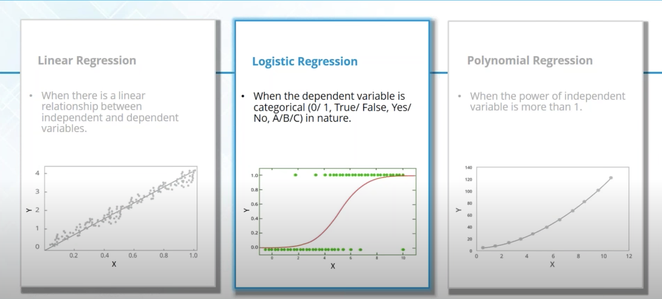
Machine Learning Technique - Regression
What is Regression: Regression is drawing relationship between attributes. There are three types of regression techniques - linear, logistic and Polynomial Regression. From these types I have taken Logistic regression.

Slide 6
What is Logistic Regression
Logistic Regression measures the relationship between the dependent variable (our label, what we want to predict) and the one or more independent variables (our features), by estimating probabilities using its underlying logistic function.
The logistic function is defined as:
logistic(η)=1/1+exp(−η)
Instead of fitting a straight line or hyperplane, the logistic regression model uses the logistic function to squeeze the output of a linear equation between 0 and 1.
This is the task of the logistic function, also called the sigmoid function. The Sigmoid-Function is an S-shaped curve that can take any real-valued number and map it into a value between the range of 0 and 1, but never exactly at those limits. This values between 0 and 1 will then be transformed into either 0 or 1 using a threshold classifier.

Slide 7
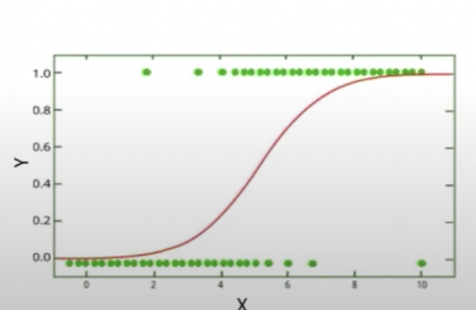
Below you can see how the logistic function (sigmoid function) looks like:
Most far from 0 values of x are mapped close to 0 or close to 1 values of y. Values close to 0 of x will be a good approximation of probability in our algorithm. Then we can choose a threshold value and transform probability to 0 or 1 prediction.

Slide 8
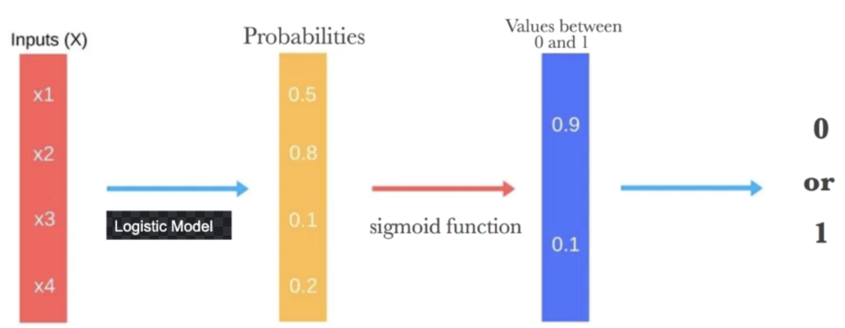
Logistic regression model predicts whether something is true or false. This curve goes from 0 to 1, this curve also means the probability of occurrence in future. This curve is drawn based on maximum likelihood of occurrence or non-occurrence of prediction based on data.
The coefficients of the logistic regression algorithm must be estimated from the training data. The best coefficients would increase the prediction probability.

Slide 9
How a machine learning algorithm gets implemented
For every machine learning task there are many steps involved to get the desired outcome.
  We need to Import the data set
  Explore the data set and understand what the data contains and understand what needs to be predicted.
  Normalize or Manipulate the data that fits to the machine learning technique.
  Apply the data modelling technique
  Predict the necessary values
For the data set we considered, we need to predict whether the transaction is 0 or 1. Such type of predictions works with logistic regression.

Slide 10
Data Set
The data set is from a credit card company which has 31 features, 28 of which have been anonymized and are labeled V1 through V28.
The remaining three features are the time and the amount of the transaction as well as whether that transaction was fraudulent or not.
As discussed in previous slide we need to import the data first and then we need to understand the data.
Let’s see how to implement this in R
Import the data set
See the structure of the data
Divide the data into training and testing
  Create a logistic model on training data set
  Predict the class for the data on test data set using the logistic model we created
  Create a table which gives the actual class value for test data and the predicted values for test data

Slide 11
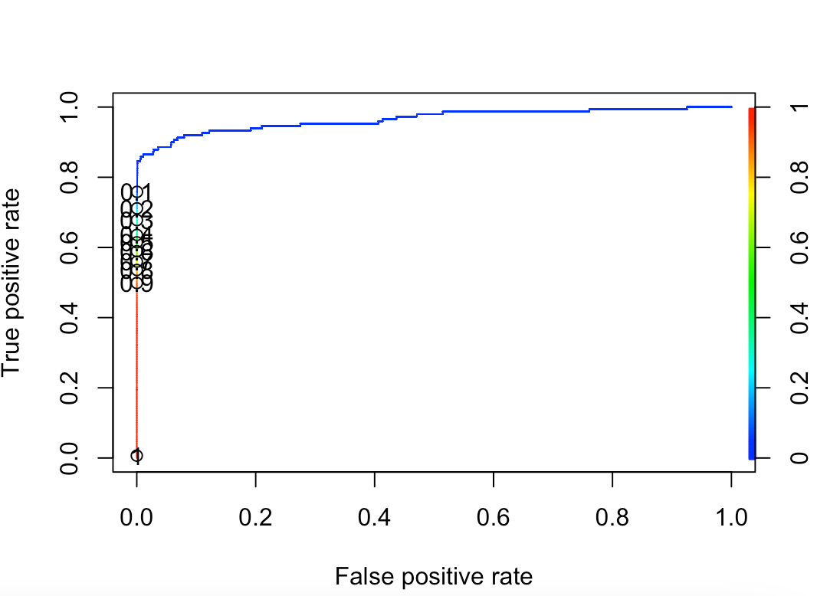
Calculate the accuracy of the predicted values and plot them in a graph .
We can see how the predicted class values are distributed between 0 and 1
This accuracy graph shows most of the values have less False Positive rate and high true positive rate. This explains the accuracy of the predictions.

Slide 12
Real-world use cases of Logistic Regression
Credit scoring
ID Finance is a financial company that makes predictive models for credit scoring. They need their models to be easily interpretable. They can be asked by a regulator about a certain decision at any moment.
Medicine
There is a huge amount of medical data about various compounds, but they are not combined into a single database. The developers use database of scientific articles and applied text analysis methods to obtain feature vectors. The text was split into the sentences, the entities were extracted and then labeled data generated from known relations .
Logistic regression is well suited for this data type when we need to predict a binary answer. Is there a connection between the elements or not? With this algorithm, the accuracy of a quick blood test have been increased.

Slide 13
Hotel Booking
Booking.com has a lot of machine learning methods literally everywhere on the site. They try to predict users' intentions and recognize entities.
Where will you go, where do you prefer to stop, what are you planning to do? Some predictions are made even if the user didn't type anything in the search line yet.
Gaming
Tencent is the world's largest gaming company. It uses such systems to suggest gamers' equipment which they would like to buy. Their algorithm analyzes a very large amount of data about user behavior and gives suggestions about equipment a particular user may want to acquire on the run. This algorithm is logistic regression.
Text editing
Logistic regression is a popular choice in many natural language processing tasks. First, the text preprocessing is performed, then features are extracted, and finally, logistic regression is used to make some claim about a text fragment. Toxic speech detection, topic classification for questions to support, and email sorting are examples where logistic regression shows good results.

Slide 14
Pros and Cons of Logistic Regression
Disadvantages of logistic regression:
Logistic Regression requires a large dataset and sufficient training examples for all the categories it needs to identify.
Each training example should be independent of all the other examples in the dataset. If they are related in some way, then the model will give inaccurate results. For example, some scientific research techniques rely on multiple observations on the same individuals. This technique can't be used in such cases.
A disadvantage of it is that we can’t solve non-linear problems with logistic regression since its decision surface is linear.
Another disadvantage is its high reliance on a proper presentation of your data. This means that logistic regression is not a useful tool unless you have already identified all the important independent variables.

Slide 15
Advantages of logistic regression:
It is a widely used technique because it is very efficient, does not require too many computational resources, it’s highly interpretable, it doesn’t require input features to be scaled, it doesn’t require any tuning, it’s easy to regularize, and it outputs well-calibrated predicted probabilities.
It is incredibly easy to implement and very efficient to train.
Logistic regression is realized in many statistical packages such as SAS, STATISTICA, R packages, and other tools. This makes it easy to use even if you do not have an advanced machine learning team for your task
Lastly, the most significant advantage of logistic regression over neural networks is transparency. Neural networks work as a black box - you never know why it makes one or another decision. There are a lot of highly regulated industries where this approach is not acceptable. Logistic regression, in contrast, may be called the “white box”. You always know why you rejected a loan application or why your patient’s diagnosis looks good or bad.

Slide 16
Conclusion
We can see clearly that using machine learning we could be able to identify which transaction is fraud and which is not without any manual intervention in the transactions.
If the data set keep increasing, then we get more accuracy on the predictions that we created using the machine learning models.
We identify the fraud transactions using multiple variables which are dependent on the class variable which gives accurate results.

Slide 17
References:
https://data-flair.training/blogs/data-science-machine-learning-project-credit-card-fraud-detection/
https://towardsdatascience.com/detecting-credit-card-fraud-using-machine-learning-a3d83423d3b8
https://towardsdatascience.com/logistic-regression-explained-9ee73cede081

